Slide 1
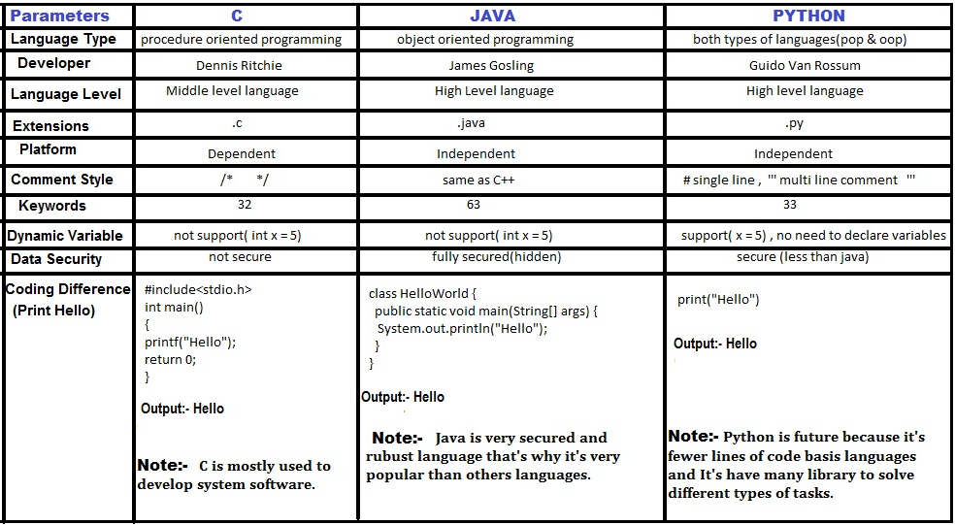
C, Java and Python

Slide 2
History of Java

Slide 3
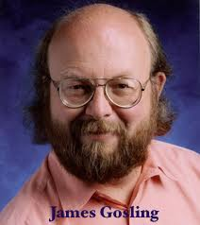
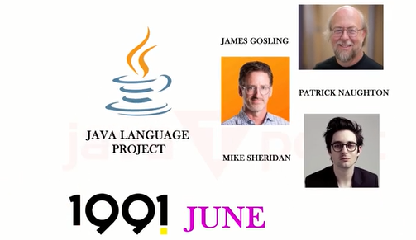
Java Team
James Gosling, Mike Sheridan, and Patrick Naughton initiated the Java language project in June 1991.
The small team of sun engineers called Green Team.
File extension - .gt

Slide 4
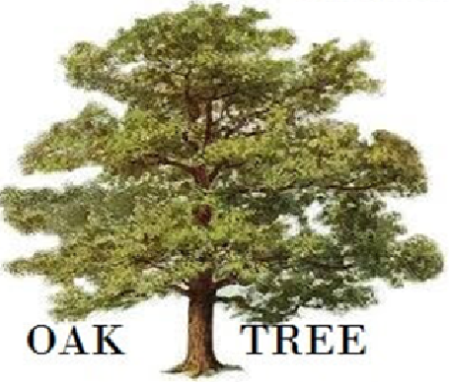
Why Java was named as "Oak"?
Oak is a symbol of strength and chosen as a national tree of many countries like the U.S.A., France, Germany, Romania, etc.

Slide 5

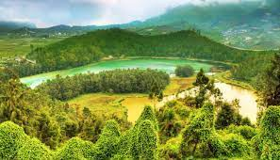
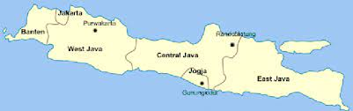
Why Java Programming named "Java"?
The team gathered to choose a new name. The suggested words were "dynamic", "revolutionary", "Silk", "jolt", "DNA", etc.
essence of the technology: revolutionary, dynamic, lively, cool, unique, and easy to spell, and fun to say.
Java is an island in Indonesia where the first coffee was produced (called Java coffee). It is a kind of espresso bean.

Slide 6
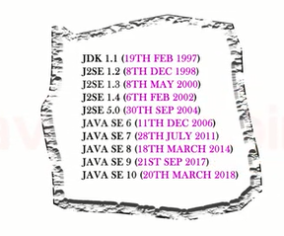
Java Versions

Slide 7
Java Versions
JDK Alpha and Beta (1995)
JDK 1.0 (23rd Jan 1996)
JDK 1.1 (19th Feb 1997)
J2SE 1.2 (8th Dec 1998)
J2SE 1.3 (8th May 2000)
J2SE 1.4 (6th Feb 2002)
J2SE 5.0 (30th Sep 2004)
Java SE 6 (11th Dec 2006)
Java SE 7 (28th July 2011)
Java SE 8 (18th Mar 2014)
Java SE 9 (21st Sep 2017)
Java SE 10 (20th Mar 2018)
Java SE 11 (September 2018)
Java SE 12 (March 2019)
Java SE 13 (September 2019)
Java SE 14 (Mar 2020)
Java SE 15 (September 2020)
Java SE 16 (Mar 2021)
Java SE 17 (September 2021)
Java SE 18 (to be released by March 2022)

Slide 8
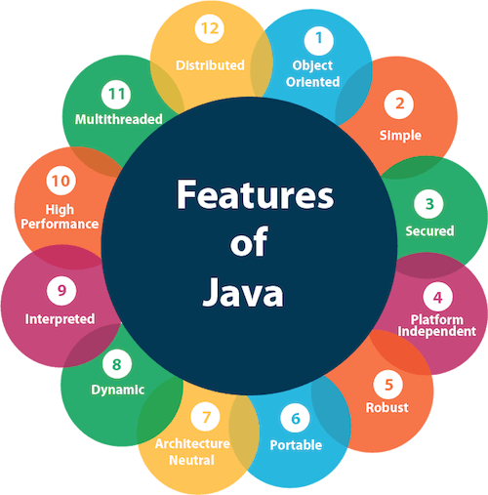
Features of Java

Slide 9
1) Simple
very easy to learn
syntax is simple
clean and easy to understand.

Slide 10
2)Object - oriented
Object
Class
Inheritance
Polymorphism
Abstraction
Encapsulation

Slide 11
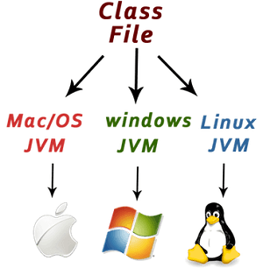
3) Platform independent
Platforms
software-based
hardware-based
WRITE ONCE, RUN ANYWHERE (WORA)

Slide 12
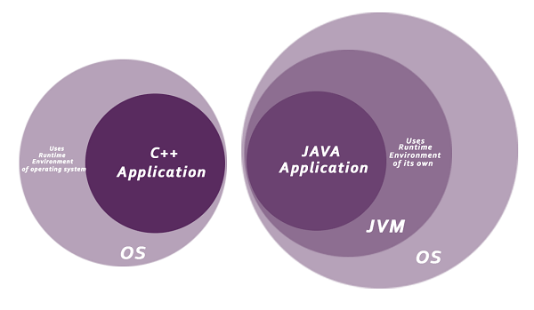
4) Secured
Java is secured because:
No explicit pointer
Java Programs run inside a virtual machine sandbox

Slide 13
4) Secured
Classloader
Bytecode Verifier
Security Manager

Slide 14
5) Robust
Strong memory management
Lack of pointers
Automatic garbage collection
Exception handling
Type checking mechanism

Slide 15
6) Architecture - neutral
Java is architecture neutral because there are no implementation dependent features
Example: size of primitive types is fixed.
4 bytes of memory -32 and 64-bit architectures

Slide 16
7) Portable
Java is portable because it facilitates you to carry the Java bytecode to any platform. It doesn't require any implementation.

Slide 17
8) High-performance
Java is faster than other traditional interpreted programming languages because Java bytecode is "close" to native code.
It is still a little bit slower than a compiled language (e.g., C++).

Slide 18
9) Distributed
Facilitates users to create distributed applications in Java.
RMI and EJB - To access files by calling the methods from any machine on the internet.

Slide 19
10) Multi-threaded
A thread is like a separate program, executing concurrently.
We can write Java programs that deal with many tasks at once by defining multiple threads.

Slide 20
11) Dynamic
Java is a dynamic language. It supports the dynamic loading of classes. It means classes are loaded on demand. It also supports functions from its native languages, i.e., C and C++.
supports dynamic compilation and automatic memory management

Slide 21
Applications of Java

Slide 22
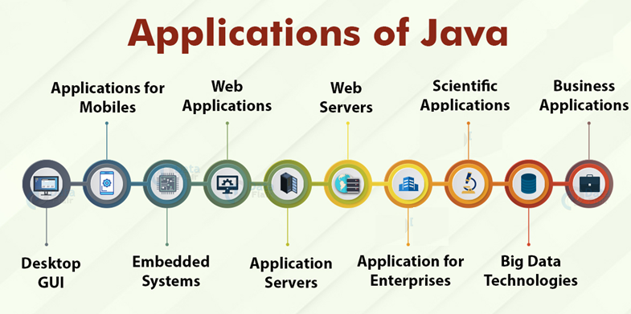
Applications of Java

Slide 23
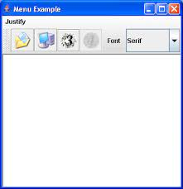

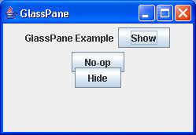
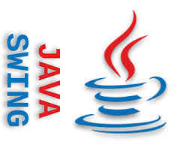
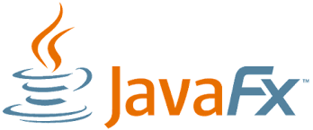
Applications of Java
1. Desktop GUI
GUI development
special packages
Abstract Windowing Toolkit
JavaFX
Swing
Acrobat Reader,
ThinkFree
Media Player
Antiviruses

Slide 24

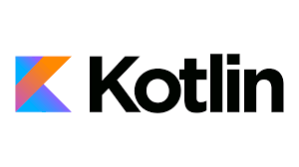


Applications of Java
2. Applications for Mobiles
android applications use Dalvik Virtual Machines
Android Application Package(APK).

Slide 25
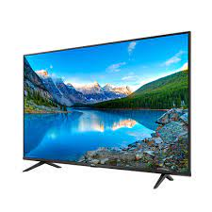
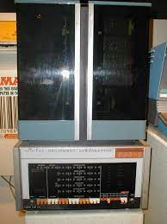
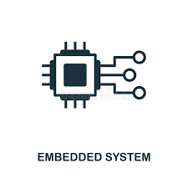

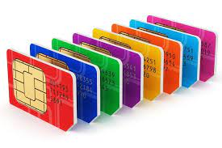
Applications of Java
3. Embedded Systems
combination of many small computing units that assemble together to perform dedicated functions
microchips and mini computers to perform dedicated tasks
SIM cards and televisions still use Java
TV devices and Blu-Ray disc players

Slide 26




Applications of Java
4. Web Applications of Java
Servlets, Struts and JSPs
develop the business logic of the web application.
high security - development of applications pertaining to health, social security, education
Eg., BroadLeaf

Slide 27
Applications of Java
Application Servers and web servers
application services
server acts like an extended virtual machine. It handles database connections on one hand and the assigned web client on another.
Eg.,WebLogic and WebSphere
web server applications
server software/hardware which satisfies the client requests on the WWW(World Wide Web). It has the job of storing, processing and delivering web pages to clients/users.
Example: Tomcat, Simpoe, Rimfaxe Web Server

Slide 28
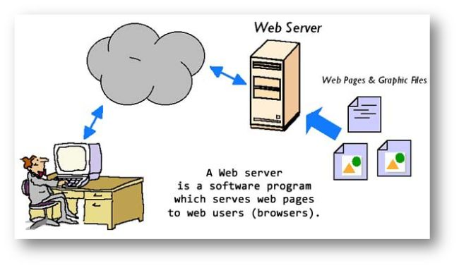
Applications of Java

Slide 29
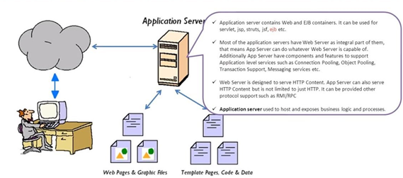
Applications of Java

Slide 30
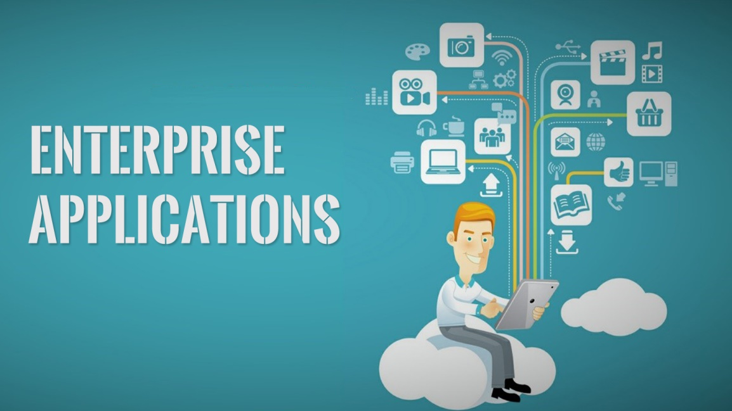
Applications of Java
Java Applications for Enterprises
Enterprise as any company which runs for profit.
robust features
“about 97% of enterprise applications use Java for development of large-scale software”
Security
Performance
Scalable

Slide 31

Applications of Java
Scientific Applications of Java
A scientific application is an application that affects real-world activities using mathematics.
secure and highly portable
same results on different platforms
MATLAB

Slide 32



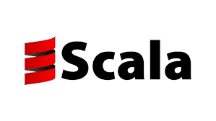



Applications of Java
Big Data Technologies
extremely large and complex datasets that may be analyzed
To extract patterns, trends, and useful information
Hadoop
Sub-projects of Java
Apache Spark
Mahout
Scala (Scalable Language)

Slide 33
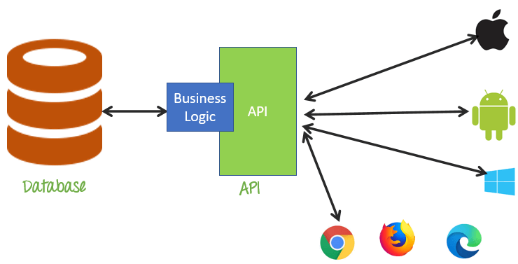
Applications of Java
Business Applications
API
development models
runtime environments

Slide 34
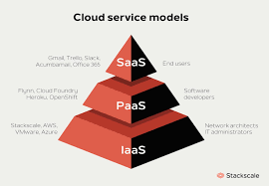
Applications of Java
Cloud-based Applications
Cloud computing means on-demand delivery of IT resources via the Internet, including storage, servers, databases, networking, and software with a pay-as-you-go pricing model.
SaaS (Software-as-a-service),
IaaS (Infrastructure-as-a-service)
PaaS (Platform-as-a-service)

Slide 35
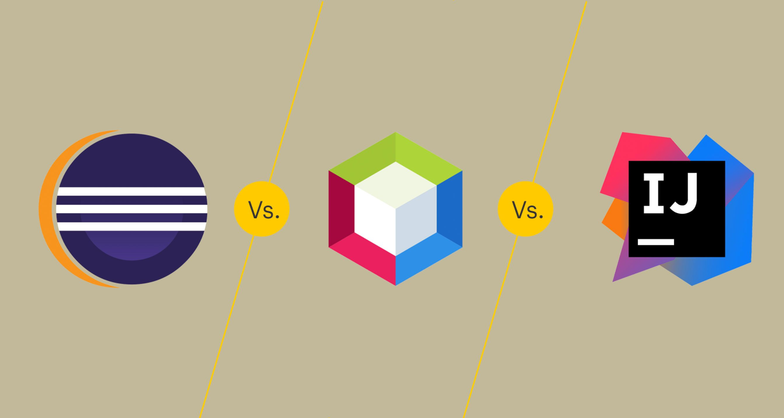
Applications of Java
Software Tools
Developers use to develop, analyze, maintain, debug, or support other applications and programs
Eclipse, IntelliJ Idea, and NetBeans IDE

Slide 36



Applications of Java
Gaming Applications
jMonkeyEngine
Dalvik Virtual Machine (DVM)

Slide 37
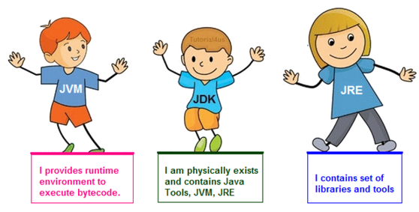
JVM, JDK and JRE

Slide 38
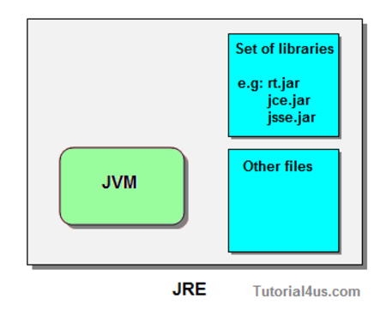
JRE

Slide 39
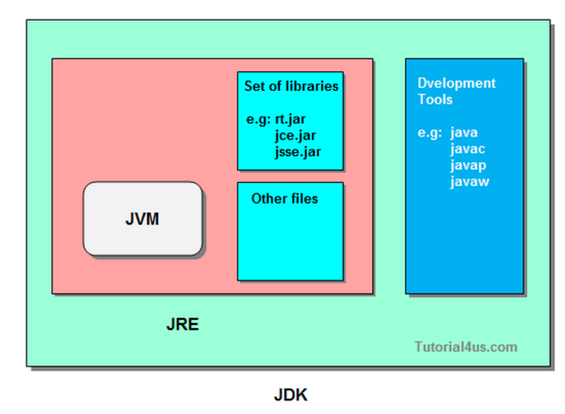
JDK

Slide 40
Primitive Data Types

Slide 41
Variable
A variable is a container which holds the value while the Java program is executed.
A variable is assigned with a data type.
Variable is a name of memory location.

Slide 42
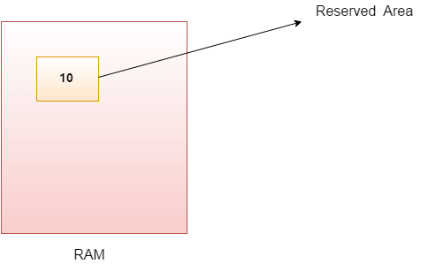
Variable
A variable is the name of a reserved area allocated in memory. In other words, it is a name of the memory location.
It is a combination of "vary + able" which means its value can be changed.

Slide 43
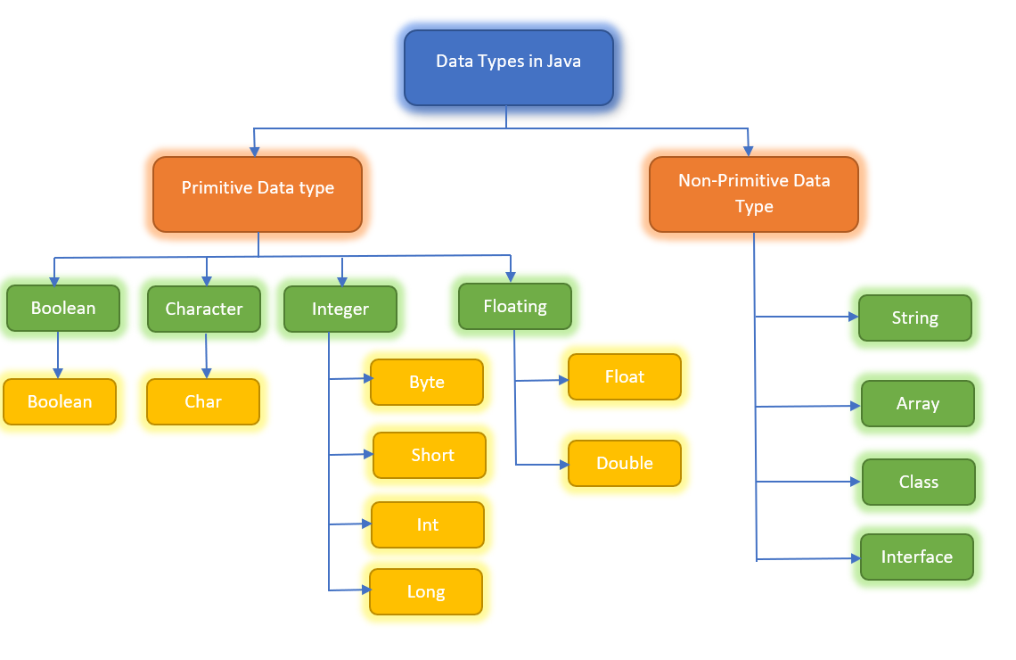
Data Types

Slide 44
Data Types
Data types are divided into two groups:
Primitive data types - includes byte, short, int, long, float, double, boolean and char
Non-primitive data types - such as String, Arrays and Classes

Slide 45
Data Types
int myNum = 5; // Integer (whole number)
float myFloatNum = 5.99f; // Floating point number
char myLetter = 'D'; // Character
boolean myBool = true; // Boolean
String myText = "Hello"; // String

Slide 46
Primitive Data Types
Integer types stores whole numbers, positive or negative (such as 123 or -456), without decimals.
Valid types are byte, short, int and long. Which type you should use, depends on the numeric value.
Floating point types represents numbers with a fractional part, containing one or more decimals.
There are two types:
float
double.

Slide 47
Primitive Types
Data Type | Size | Description
byte | 1 byte | Stores whole numbers from -128 to 127
short | 2 bytes | Stores whole numbers from -32,768 to 32,767
int | 4 bytes | Stores whole numbers from -2,147,483,648 to 2,147,483,647
long | 8 bytes | Stores whole numbers from -9,223,372,036,854,775,808 to 9,223,372,036,854,775,807
float | 4 bytes | Stores fractional numbers. Sufficient for storing 6 to 7 decimal digits
double | 8 bytes | Stores fractional numbers. Sufficient for storing 15 decimal digits
boolean | 1 bit | Stores true or false values
char | 2 bytes | Stores a single character/letter or ASCII values

Slide 48
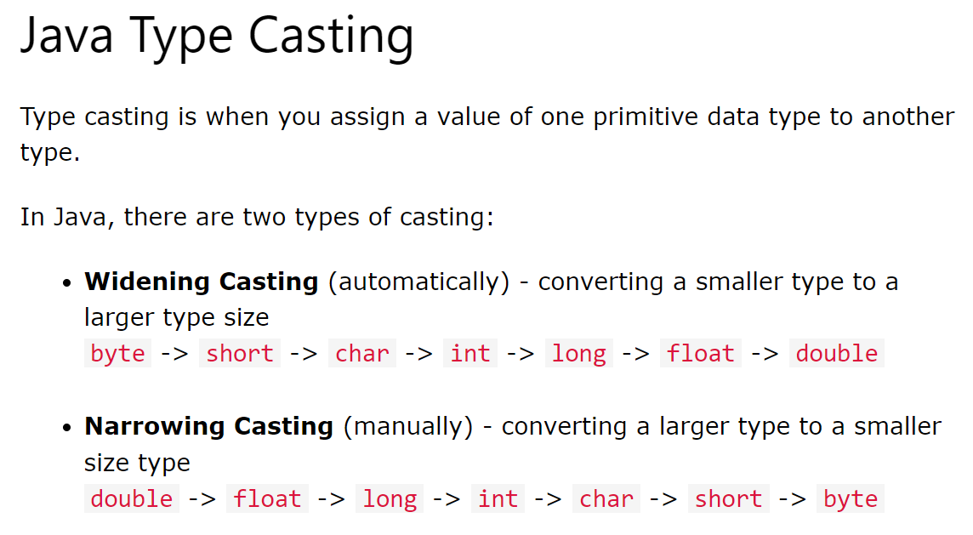

Slide 49
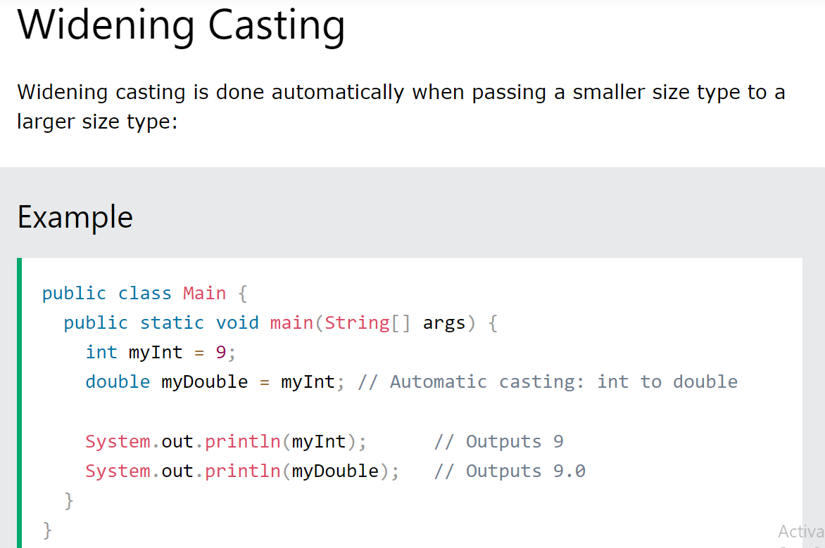

Slide 50
